Slide 1



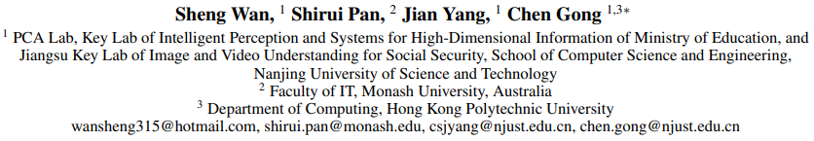

ATAI
Chongqing University of Technology
Advanced Technique of Artificial Intelligence
Chongqing University of Technology
AAAI2021_Contrastive and Generative Graph Convolutional Networks for Graph-based Semi-Supervised Learning
Binyan Zhang
zby@2018.cqut.edu.cn
2021.02.23 • Henan

Slide 2
Outline
Motivation
Approach
Experiments
Conclusion
Notes:
接下来我们将从以下几个方面来介绍这篇文章

Slide 3
Motivation
Although graph-based SSL methods have achieved noticeable progress in recent years,
they do not directly tackle the core problem of SSL, namely the shortage of supervision;
2) One should note that the number of labeled data in SSL problems is usually very limited,
which poses a great difficulty for stable network training and thus will probably degrade
the performance of GCNs.

Slide 4
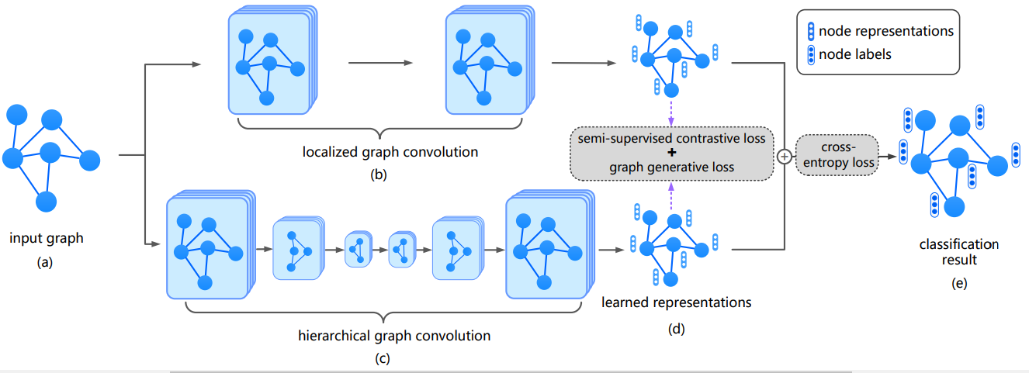
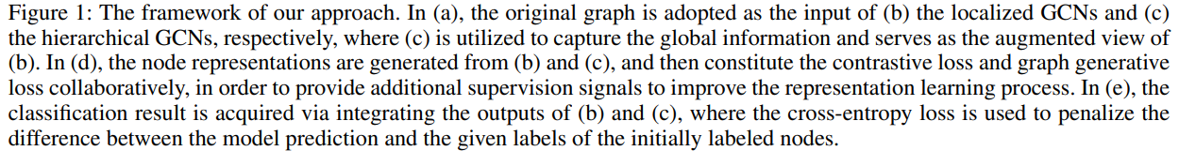
Approach

Slide 5
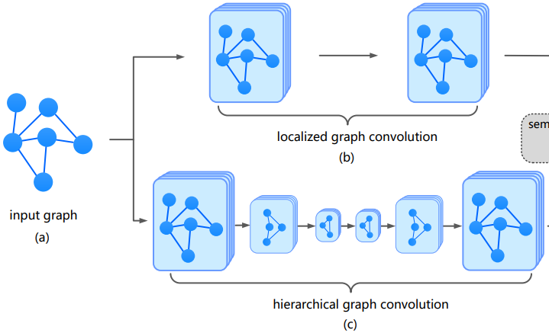
Approach

Slide 6
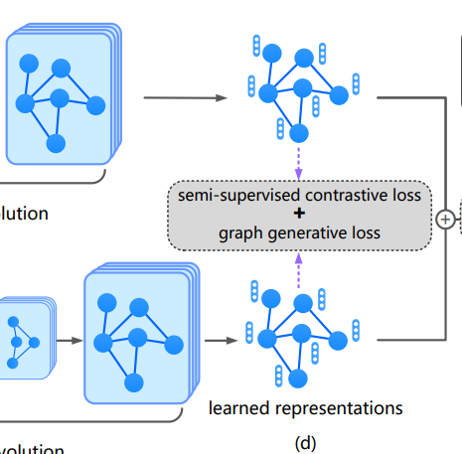
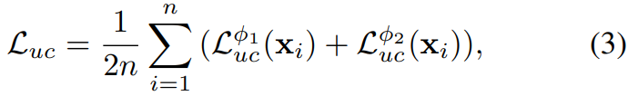
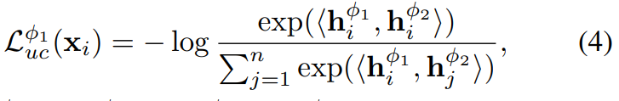


Approach

Slide 7
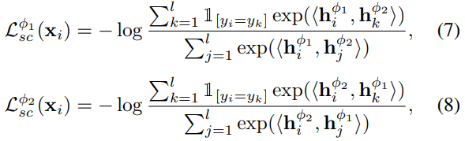
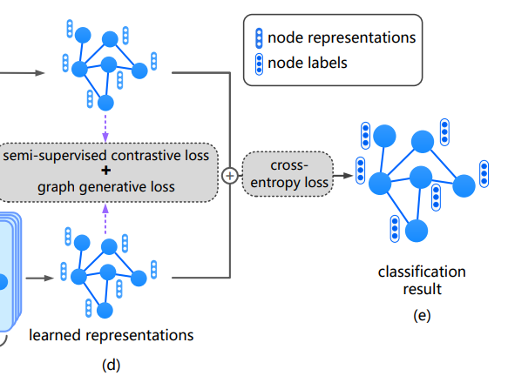

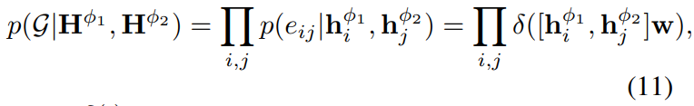

Approach

Slide 8


Approach

Slide 9
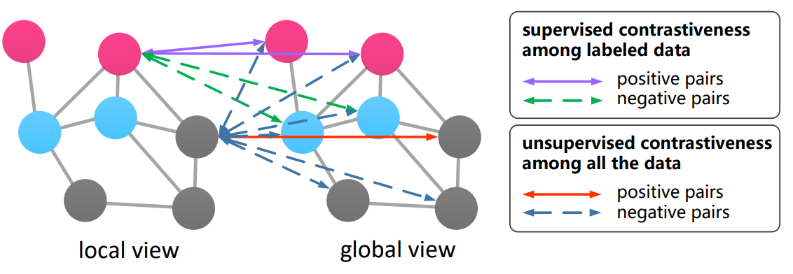
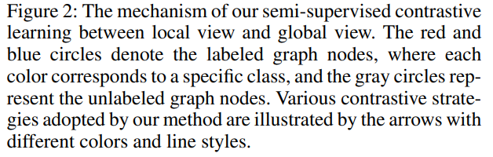
Approach

Slide 10
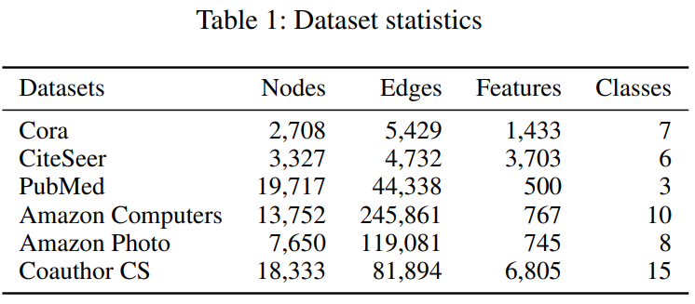
Experiments

Slide 11
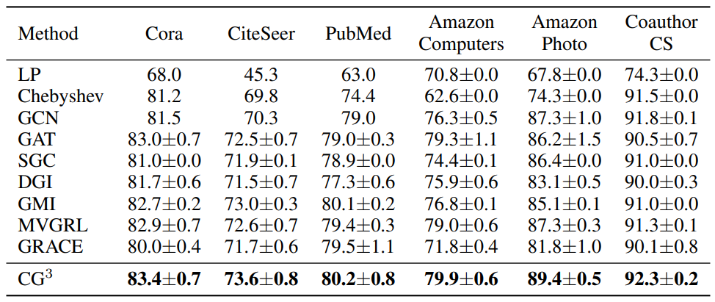
Experiments

Slide 12
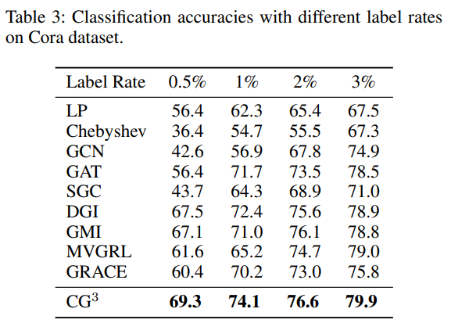
Experiments

Slide 13
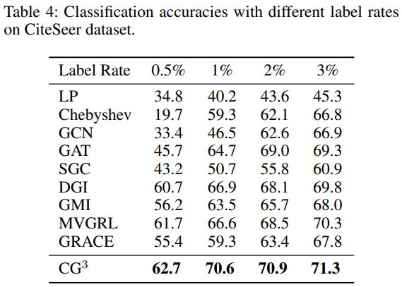
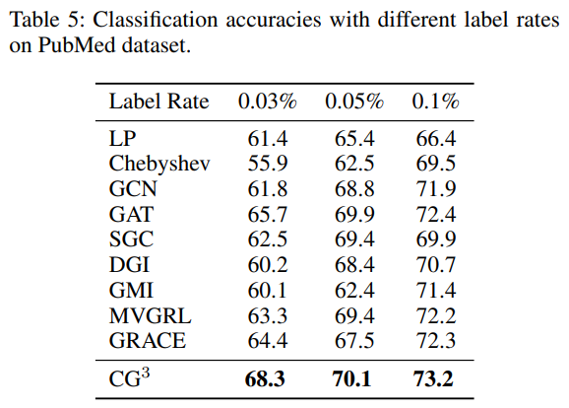
Experiments

Slide 14
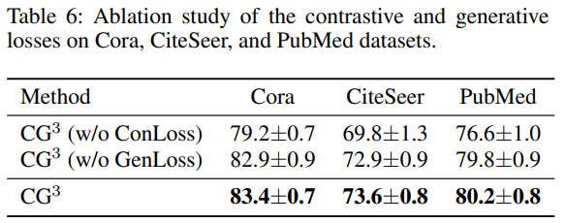
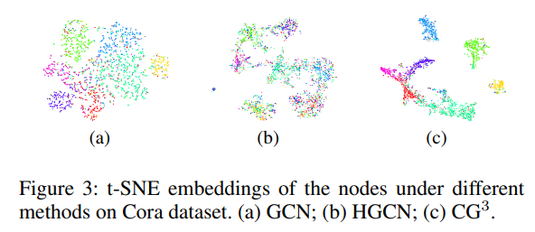
Experiments

Slide 15
Conclusion
They designing a semi-supervised contrastive loss, the scarce yet valuable class information, together with the data similarities, can be used to provide abundant supervision information for discriminative representation learning.
The supervision signals can be further enriched by leveraging the underlying relationship between the input graph topology and data features.

